Slide 1
A4 - IDOR (Insecure Direct Object Reference)

Slide 2
A4: IDOR
Object:
Data, information, Files , images, videos, resources, directory, database key etc
Reference:
Where the object is located

Slide 3
When?
The references of the objects are not secured
What ?
View the data of other users
Upload or modify the data of other user
How to keep the secure?
Authorization – What you are allowed to
Authentication – Who you are
Use indirect reference to call the objects

Slide 4
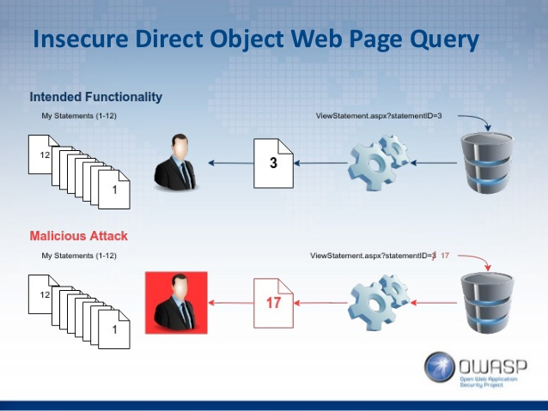

Slide 5
Where to Test?
When the application relays on the user input to retrieve the data.
Example: login, get data from db by user id
When the objects are uploaded by user in the application.
Example: Upload the files to server

Slide 6
How to test?
Think of multiple users and their authorization/authentication.
Map all the locations in the application where the user inputs are used to access db , file , application pages.

Slide 7
Examples:
The value of a parameter is used directly to perform an operation in the system http://foo.bar/changepassword?user=someuser
The value of a parameter is used directly to retrieve a database record
http://foo.bar/somepage?invoice=12345
The value of a parameter is used directly to retrieve a file system resource
http://foo.bar/showImage?img=img00011 (path traversal)
The value of a parameter is used directly to access application functionality
http://foo.bar/accessPage?menuitem=12

Slide 8
A6 –Sensitive Data Exposure

Slide 9
What is sensitive data?
Banking information (account number, credit card numbers, transactions)
Health information
Personal information (date of Birth, SSN/SIN)
Social security questions and answers
User account/passwords

Slide 10
When can happen ?
During the transport of data from client to server and server to client
At database
When displayed in the application
What can be done?
Financial loss
Identity hi-jacking
Decreased brand trust

Slide 11
How to prevent?
Encrypt the data during the transport layer and the application
Minimize the data surface
Use the latest encryption algorithms
Disable auto complete on forms that collect data
Disable caching on forms that collect data

